Slide 1
Research
in Paediatric Palliative Medicine

Slide 2
Outline
Is research for me?
Share some of my experiences
Project develop process and pitfalls
Phase I/II trials
Delivering new agents
Supporting trials
How to
Setting up research team and program
Tips
Your personal engagement and development in research

Slide 3
Why do (or not) research
Actively engage with research
Avoid at all cost
Personal and team satisfaction
Potential to impact directly on patient care
Collaboration beyond NHS, charities and private funders and organisations
Local, national and international impact
Local, national and international meaningful contribution
Time
Time
Time
Energy better spent elsewhere?
Processes
Rigorous review by external bodies
Deadlines and timeframes
Commitment
Funding
getting it
Maintaining it
Feeding back
Creating jobs -responsible for the sustainment

Slide 4
Types of research
Everyman research:
‘Audit’
Case report and case series
Retrospective review
Single centre prospective observational study
Clinical:
Randomised controlled trial
Cross-over and cohort studies
Multi-centre project
Quantitative and qualitative
Laboratory based or beloved ‘translational’ research:
New agents and drug company work

Slide 5
A project
Idea- what is already out there
Work this idea up
Feasibility
Resources
Team skills/Training
Research and development (R&D)
Ethics
Proportionate review
Committee
Project starts
Peer and/or user review
During project
Annual ethics update
Recruitment
Feedback to reviews
Feedback to funders
After project
Analysis
Statistician review
Write up
Dissemination
Funding

Slide 6
Surprise Question
Idea: SQ in Paediatrics?
Work this idea up
Feasibility-Yes
Resources- Yes
Team skills- MDT
Research and development (R&D)
Ethics- not needed- SE
Proportionate review
Committee
Project starts
Peer and/or user review: adult published methodology
During project- not needed
Annual ethics update
Recruitment
Feedback to reviews
Feedback to funders
After project- needed funding!
Analysis
Statistician review
Write up- in process
Dissemination- EAPC
Funding-No
?Training-No
Data analysis

Slide 7
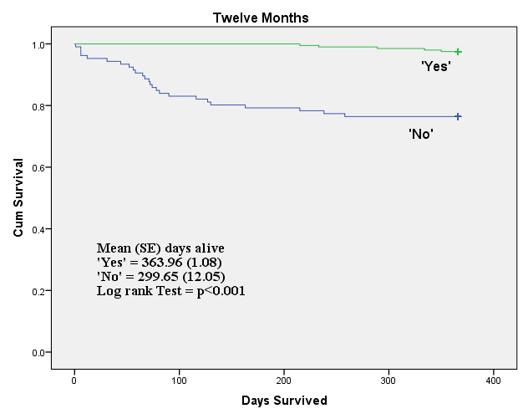
Surprise question

Slide 8
SYMPTOM ASSESSMENT TOOL
Take 5 steps back
Idea: develop a PPC Symptom tool
Work this idea up
Feasibility-NO
Resources-YES
Team skills/Training
Research and development (R&D)
Ethics
Proportionate review
Committee: well received
Project starts
Peer and/or user review: Parent group, P/P NIHR group and feedback funding bids
During project
Annual ethics update
Recruitment SLOW- change strategy
Feedback to funders
Statistician review-numbers important
Funding- Yes specific
Recruitment key issue

Slide 9
Decision-making on PICU
Interviews
Idea: qualitative and quantitative
Work this idea up
Feasibility YES?
Resources-YES
Team skills NO
Research and development (R&D)
Ethics
Proportionate review
Committee: accepted-parent group
Project starts
Peer and/or user review: parent group
During project
Recruitment: interviews
Statistician review
Funding- YES
?Training NO

Slide 10
Phase of Illness project
Idea
Work this idea up
Feasibility
Resources
Team skills
Research and development (R&D)
Ethics
Proportionate review
Committee
Project starts
Peer and/or user review
During project
Annual ethics update
Recruitment
Feedback to reviews
Feedback to funders
After project
Analysis
Statistician review
Write up
Dissemination
Funding
?Training
International collaboration

Slide 11
Phase i/ii
Early phase trials

Slide 12
PHASE I/II/II
The earliest phase trials -drug is safe and the side effects
A later phase trial tests- new treatment is better than existing treatment
Three main phases of clinical trials – phases 1 to 3. (some 0-4 trials)
Phase 1 trials
determine drug dose safety, what the side effects are, how the body copes with the drug and if the treatment shrinks the cancer
Patients are recruited as small cohorts with escalating doses of drug per cohort- a dose escalation study. ‘First in study’ (first patient recruited)
Phase 2 trials
Looks at response to go to a larger phase 3 trial
Phase 3 compare a completely new treatment with the standard treatment
Different doses or ways of giving a standard treatment
Phase 4 trials are done after a drug has been shown to work and has been granted a licence.
What the long term risks and benefits are
How well the drug works when it’s used more widely

Slide 13
PPC supporting research
RM largest phase I/II program in Europe
10-30 trials open and actively recruiting
Role of PPC
Increasing PPC and phase I/II trials hand in hand
Unique challenges:
Unknown symptoms
Drug interactions and exclusions/inclusions eg DXM
Impact of symptom prescribing on investigations eg LFTS.
Identifying symptoms that might preclude or lead to trial stoppage
Going on and coming off trials
Measurable disease and response
Decision-making
Good symptom control can enable recruitment to a trial, remain on trial and in some cases have lead to life prolonging and life sustaining treatment.

Slide 14
HOW TO

Slide 15
How to set up a research team/program
Your research
Environment-Hospital/Hospice
Infrastructure of organisation
Already established research
Phase I/II established
Statistic support
Soft issues
Mentorship
Organisational culture
Experience and training
You
Your team
Funding

Slide 16
How to get off the ground (Tips)
Idea(s)
Small projects:
Poster/presentations at national/international conference
Publish
Funding
Larger projects
Parents group (end user group)
Idea
Funding
Project

Slide 17
Funding
Part of your post
Team to support
Small grants
Targeted eg headaches -brain tumour charity
Large grants
NIHR approved
International
Multi-centre
Large numbers
Proven track record
Businesses and corporates
May need to be part of fundraising
Presentations to boards (non-medical)
Families
Name of child
Hard for others to donate to
Pharmaceutical industry
Established program and team
Cost effectiveness
Proven track record

Slide 18
OUR FUNDING
Our funding
Small grants for specific projects
Drug trial research
Trust funding for posts
Private funding relationships
Part of post
Individual donations

Slide 19
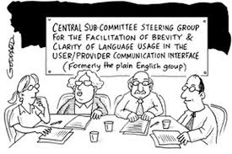
User group
Establish user group for clinical care
Bereaved parent group (>1yr bereaved)
2 yrs on group
Parent chair
TOF
Email and F2F
Meet 2-3 per year
Excellent for
Ethics committees
Review of projects
Support recruitment

Slide 20
If I can….you can
No higher degree
No prior research job or experience
Jobbing consultant since 1st April 2008
Research rich environment
Established PPC research team 2015
Qualitative and Quantitative research program
Solo and collaborative projects
New agents
End user group- 6 years
Service
Research
Funding sources
CM Trust
The Wellesley
Individual donations
Various awarded grants
Drug companies
National involvement
Formulary
PANG guidelines
NIHR group
Achievements
Publishing and presenting
International prize and recognition
Expert in PPC outcomes
EMA
Cochrane review
International collaborations
Invited expert at EAPC
Established relationship pharmaceutical industry
Only centre to complete phase I trial

Slide 21
YOU?
Get involved
Guidelines
Training/Education
GCP training
Larger projects
Involved- method, data analysis, recruitment
Small published projects
Case reports/series
Audits
Local/national
Statistics
Qualitative
Computer programs
Peer reviewer
Presented conferences
Published
Write/research for publication

Slide 22
You and research
NOW
FUTURE
Writing and submitting for :
Conference
publication
Join project
Get involved in other ways:
Join local and national groups contribute to research
Chapters or guidance
Be a Peer reviewer
What training do you need?
Your vision
Consider a higher degree
Consider further training
You and your personal development/ role
Specific interests and topics
Quantitative and qualitative
Write and take forward a project through R&D and ethics
Gain experience. Learn from the process

Slide 23
hAPPY RESEARCHING

